Slide 1
DSD/ACD/ACT1 Otis Ken Sol
31 Aug, 2024

Slide 2
Outline
MBIST flow
STA
GBA – PBA
Flatten, Harden, ETM
Compare Pre – Post STA
Sign-off
Signal Integrity
DRC, SPEF, SDF
Fix Violate
Change Frequency
Achivement
Q&A

Slide 3
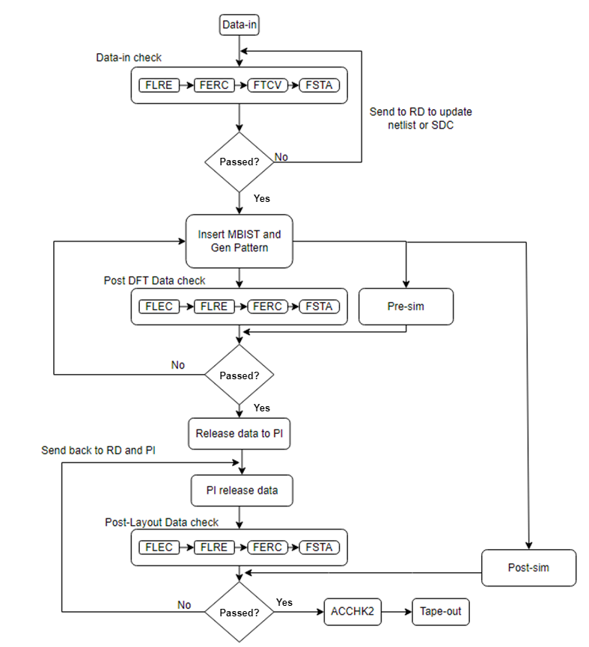
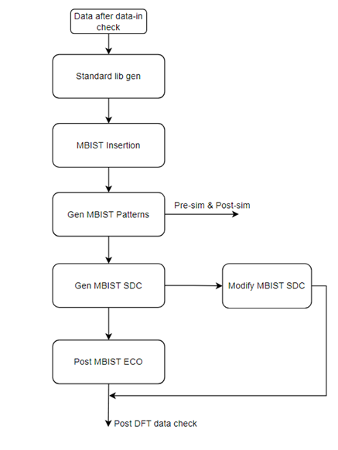
TESTCHIP FLOW
Pre-DFT
MBIST FLOW
Post-DFT
Post-layout

Slide 4
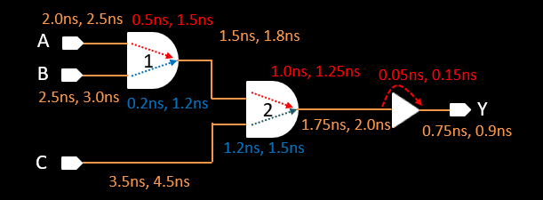
GBA and PBA
AND gate (1) has 2 input. 2 set of input-output delay combination:
Min delay A = 0.5ns, Max delay A = 1.5ns
Min delay B = 0.2ns, Max delay B = 1.2ns
Similarly, for other logic gates

Slide 5
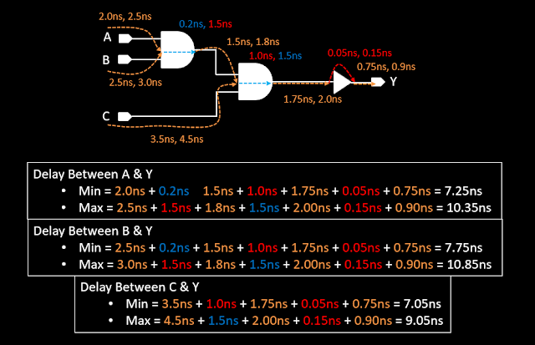
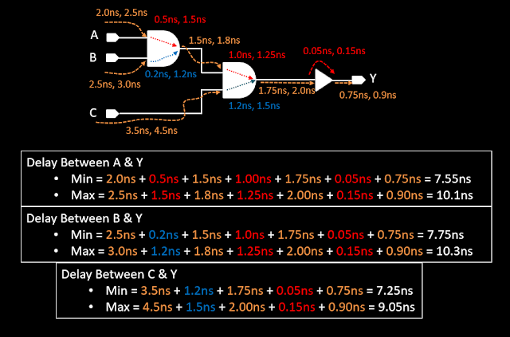
Delay Calculation in GBA and PBA
GBA – Graph Based Analysis
PBA – Path Based Analysis

Slide 6
Compare GBA and PBA result
Path | Min (ns) |  | Max (ns)
 | GBA | PBA | GBA | PBA
Delay between A&Y | 7.25 | 7.55 | 10.35 | 10.1
Delay between B&Y | 7.75 | 7.75 | 10.85 | 10.3
Delay between C&Y | 7.05 | 7.25 | 9.05 | 9.05
Min_delay_GBA <= Min_delay_PBA
Max_delay_GBA >= Max_delay_PBA
Method | Advantage | Disadvantage
Graph Based Analysis | Fast running time | More pessimism
Path Based Analysis | More accurate | Long running time

Slide 7
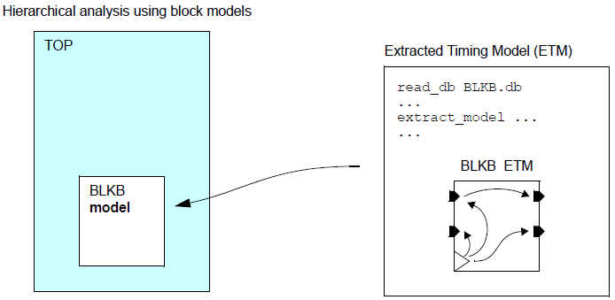
Extracted Timing Model
ETM is an abstract representation of a block
The model can be used in place of the block’s netlist for timing analysis at a higher level of the design hierarchy

Slide 8
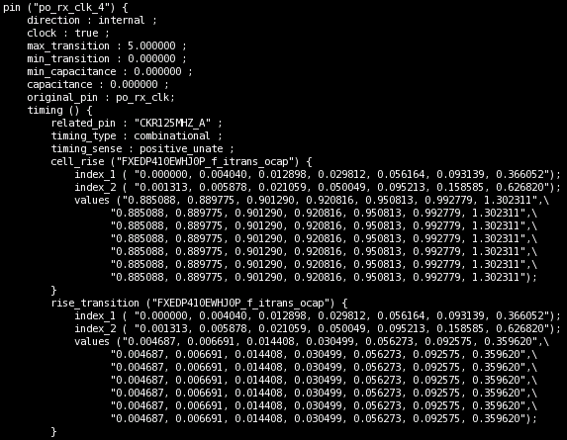
Extracted Timing Model
The model consists of a set of timing arcs between the clock, input and output pins of the block
Represents delay of timing arcs as a function of input transitions and output loads in the form of NLDM and CCS lookup tables
Input transition
Output load

Slide 9
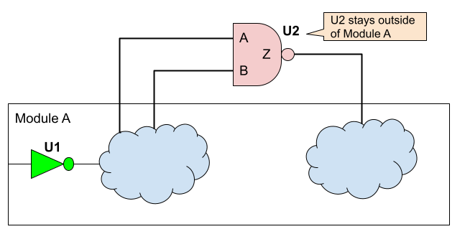
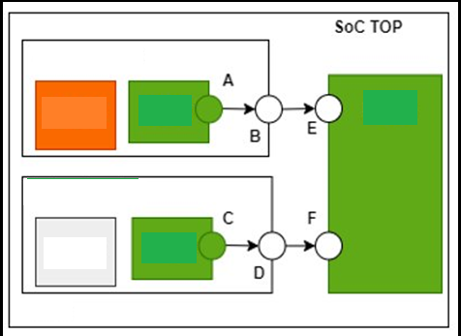
FLATTEN – Non FLATTEN
A flat design: treats the ASIC as a single, monolithic entity, without any submodules or levels of hierarchy and uses basic components like gates, transistors, and wires
Hierarchical design: divides the ASIC into smaller and simpler modules or blocks with specific functions and interfaces, which are then connected by a top-level structure. ETM supports timing extraction according to Non Flatten (Harden)
Hierarchical design
Flat design

Slide 10
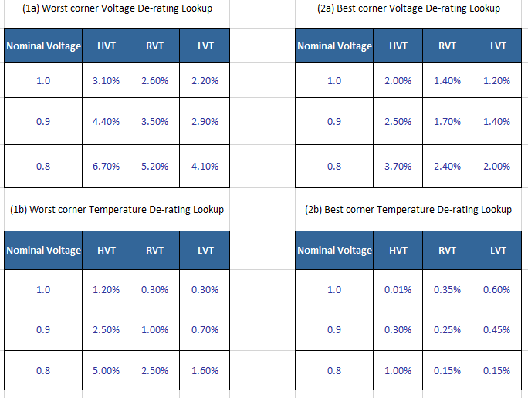
CELL TYPES
LVT: causes more power consumption and switching timing is optimized; used in time critical functions
SVT or RVT: offers trade-off between HVT and LVT i.e. moderate delay and moderate power consumption
HVT: causes less power consumption but timing is not optimized; used in power critical functions
ULVT: has maximum leakage value and is faster in terms of delay than the SVT group

Slide 11
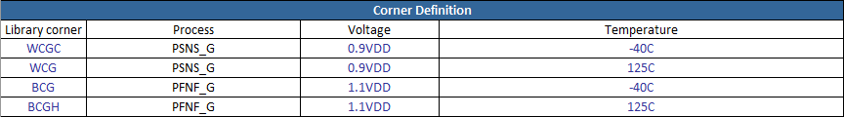
LIBRARY CORNER
The PVT corners: conditions the STA analysis takes place
WCGC: Process slow, Voltage min, Temperature min
WCG: Process slow, Voltage min, Temperature max
TYP: Process typical, nominal Voltage, nominal Temperature
BCG: Process best, Voltage max, Temperature min
BCGH: Process best, Voltage max, Temperature max

Slide 12
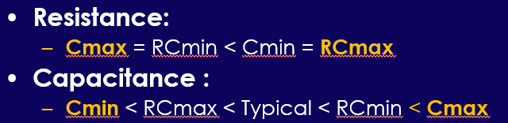
RC CORNER
Cmax: largest delay for paths with short nets, used for max path analysis
Cmin: smallest delay for paths with short nets, used for min path analysis
Typical: refers nominal value for interconnect resistance and capacitance
RCmax: largest delay for paths with long interconnects, used for max path analysis
RCmin: smallest delay for paths with long interconnects, used for min path analysis

Slide 13
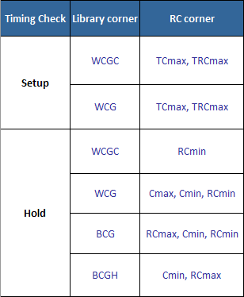
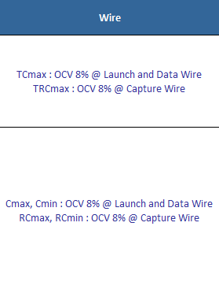
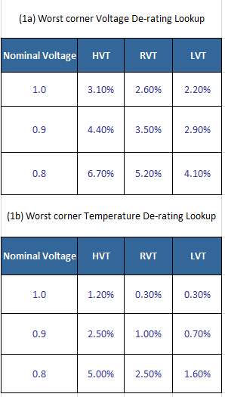
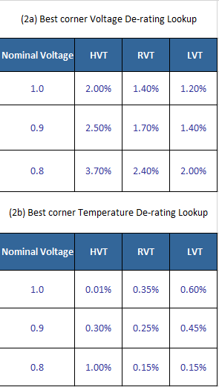
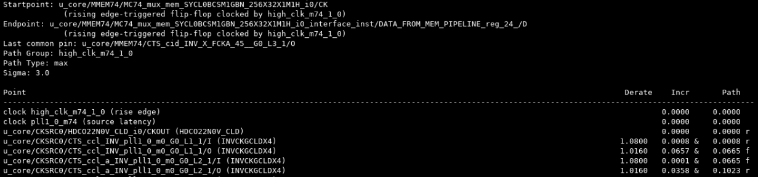
TCmax:

Slide 14
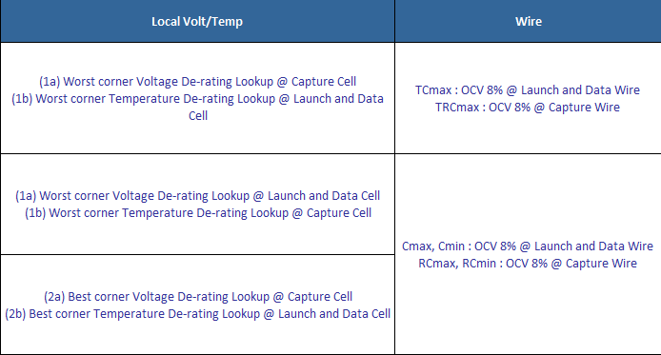
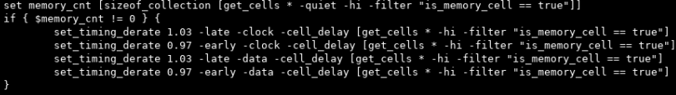
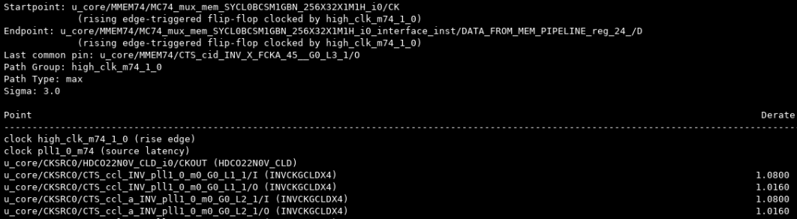
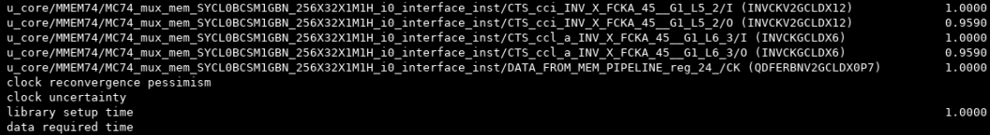
TCmax:
+8% Launch and Data Wire
+1.6% Launch and Data cell
-4.1% Capture cell

Slide 15
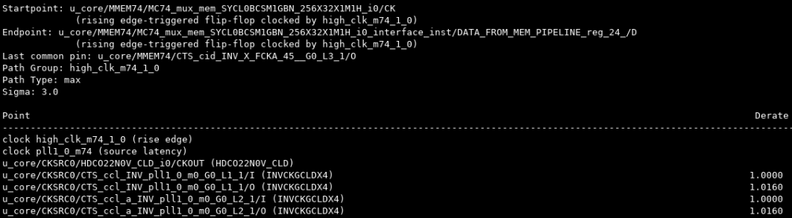
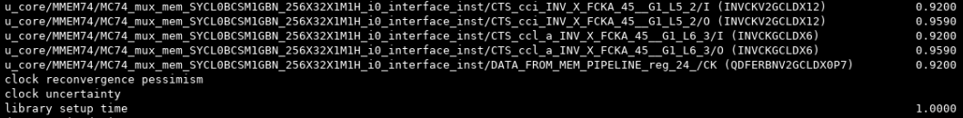
TRCmax:
+1.6% Launch and Data cell
-4.1% Capture cell
-8% Capture wire

Slide 16
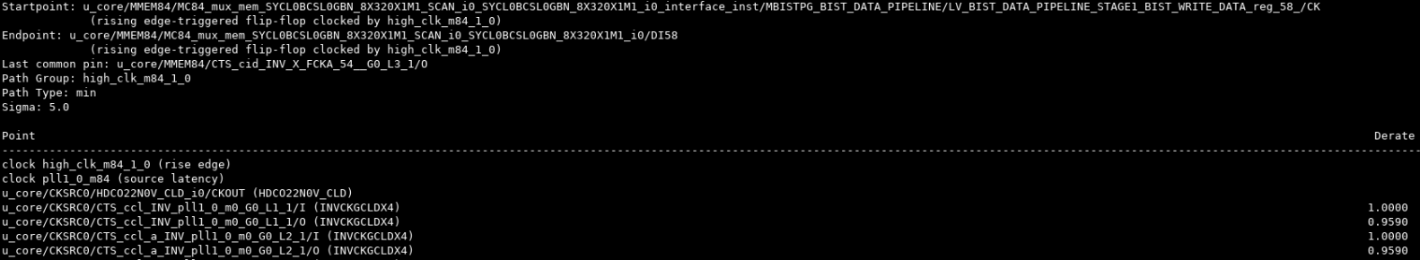
RCmin:
-4.1% Launch and Data cell
+8% Capture wire
+1.6% Capture cell

Slide 17
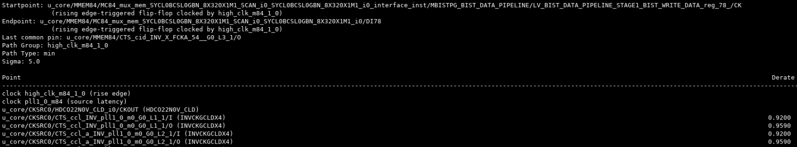
Cmax:
-8% Launch and Data wire
-4.1% Launch and Data cell
+1.6% Capture cell

Slide 18

RCmax:
-0.15% Launch and Data cell
+8% Capture wire
+2% Capture cell

Slide 19
Cmin:
-0.15% Launch and Data cell
-8% Launch and Data wire
+2% Capture cell

Slide 21


Thank You

Slide 22
Confidential information
The material is being disclosed to you pursuant to a non-disclosure agreement between you or your employer and Faraday. Information disclosed in this presentation may be used only as permitted under such an agreement.
Legal notice
The information contained in this presentation is intended to provide a general guide as to which product is suited for a given requirement and shows suggested product applications. Specified functions and properties for products are only valid when handling instructions and other stated conditions and recommendations have been considered and followed. All descriptions, illustrations and dimensions in the information represent general particulars and do not form part of any contract. All information is provided “as is”, with no guarantee of completeness, accuracy, timeliness or of the results obtained from the use of the information, and without warranty of any kind, express or implied, including but not limited to warranties of performance. All information is subject to change without prior notice. Faraday assumes no responsibility whatsoever for any errors or inaccuracies about the information.

